Slide 1
Speech Task Overview 2
Болотов Дмитрий

Slide 2
План:
Voice assistant pipeline
User perceived latency - Keyword detection - Endpoint detection

Slide 3

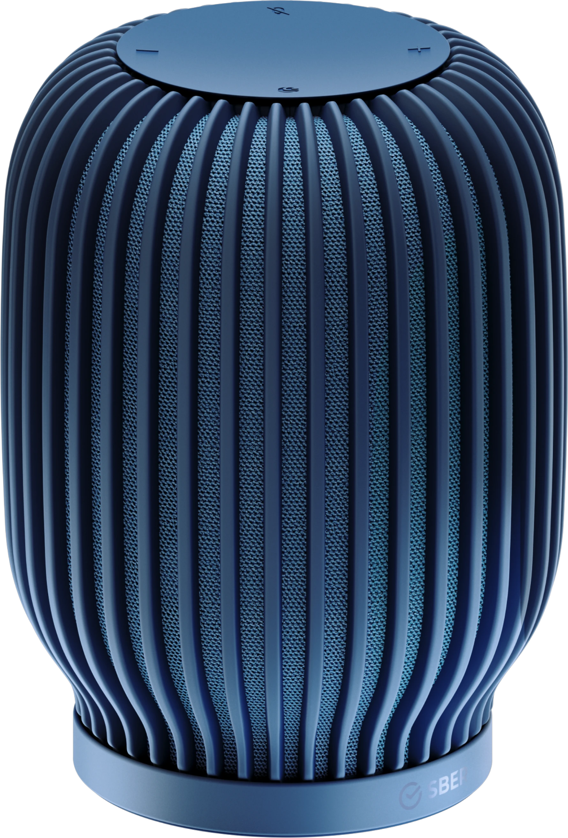

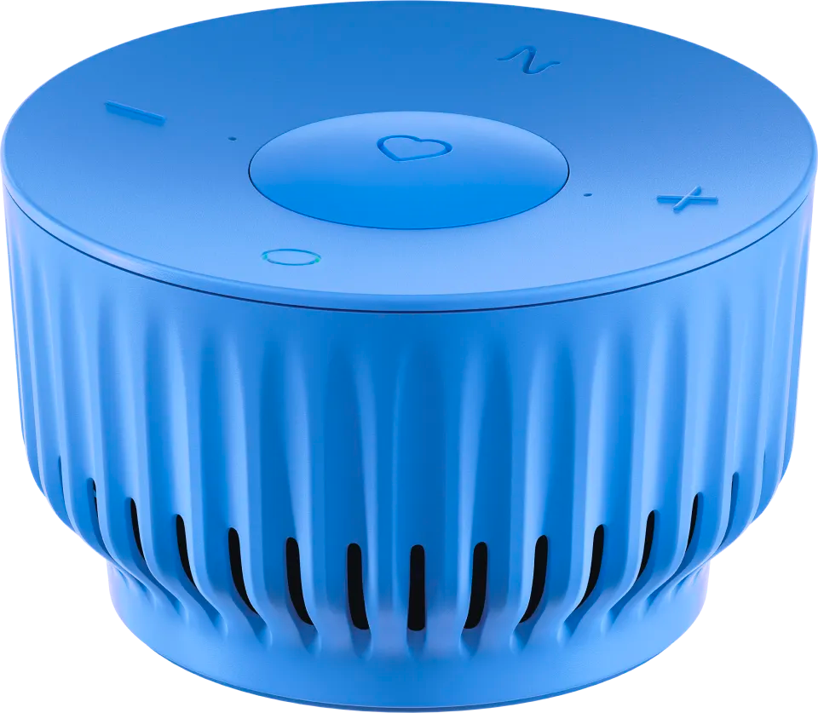

Slide 4


Voice assistant pipeline

Slide 5

Voice assistant pipeline

Slide 6
Voice assistant pipeline
Speech Enhancement

Slide 7

Voice assistant pipeline
Speech Enhancement

Slide 8
Voice assistant pipeline
Speech Enhancement
Keyword Detection

Slide 9
Voice assistant pipeline
Speech Enhancement
Keyword Detection

Slide 10
Voice assistant pipeline
Speech Enhancement
Keyword Detection

Slide 11
Voice assistant pipeline
Keyword Validation
Speech Enhancement
Keyword Detection

Slide 12
Voice assistant pipeline
Keyword Validation
Intended Query Detection
Speech Enhancement
Keyword Detection

Slide 13
Voice assistant pipeline
Keyword Validation
Intended Query Detection
Speech Recognition
Speech Enhancement
Keyword Detection

Slide 14
Voice assistant pipeline
Keyword Validation
Intended Query Detection
Speech Recognition
Endpoint Detection
Speech Enhancement
Keyword Detection

Slide 15
Voice assistant pipeline
Keyword Validation
Intended Query Detection
Speech Recognition
Endpoint Detection
Speech Enhancement
Keyword Detection
Whisper Detection

Slide 16
Voice assistant pipeline
Keyword Validation
Intended Query Detection
Speech Recognition
Endpoint Detection
Speech Enhancement
Keyword Detection
Whisper Detection
Emotion Detection

Slide 17
Voice assistant pipeline
Keyword Validation
Intended Query Detection
Speech Recognition
Endpoint Detection
Speech Enhancement
Keyword Detection
Whisper Detection
Emotion Detection
Speaker Identification

Slide 18
Voice assistant pipeline
Keyword Validation
Intended Query Detection
Speech Recognition
Endpoint Detection
Speech Enhancement
Keyword Detection
Whisper Detection
Emotion Detection
Speaker Identification
Speech Separation

Slide 19
Voice assistant pipeline
Keyword Validation
Intended Query Detection
Speech Recognition
Endpoint Detection
Speech Enhancement
Keyword Detection
Whisper Detection
Emotion Detection
Speaker Identification
Speech Separation
салют какая погода в москве

Slide 20
Voice assistant pipeline
Keyword Validation
Intended Query Detection
Speech Recognition
Endpoint Detection
Speech Enhancement
Keyword Detection
Whisper Detection
Emotion Detection
Speaker Identification
Speech Separation
Text Normalization
салют какая погода в москве

Slide 21
Voice assistant pipeline
Keyword Validation
Intended Query Detection
Speech Recognition
Endpoint Detection
Speech Enhancement
Keyword Detection
Whisper Detection
Emotion Detection
Speaker Identification
Speech Separation
Text Normalization
Салют какая погода в Москве

Slide 22
Voice assistant pipeline
Keyword Validation
Intended Query Detection
Speech Recognition
Endpoint Detection
Speech Enhancement
Keyword Detection
Whisper Detection
Emotion Detection
Speaker Identification
Speech Separation
Text Normalization
Punctuation Prediction
Салют какая погода в Москве

Slide 23
Voice assistant pipeline
Keyword Validation
Intended Query Detection
Speech Recognition
Endpoint Detection
Speech Enhancement
Keyword Detection
Whisper Detection
Emotion Detection
Speaker Identification
Speech Separation
Text Normalization
Punctuation Prediction
Салют, какая погода в Москве?

Slide 24
Voice assistant pipeline
Keyword Validation
Intended Query Detection
Speech Recognition
Endpoint Detection
Speech Enhancement
Keyword Detection
Whisper Detection
Emotion Detection
Speaker Identification
Speech Separation
Text Normalization
Punctuation Prediction
Салют, какая погода в Москве?
Assistant platform: Intent recognition, Search, Dialog Management, Skills

Slide 25
Voice assistant pipeline
Keyword Validation
Intended Query Detection
Speech Recognition
Endpoint Detection
Speech Enhancement
Keyword Detection
Whisper Detection
Emotion Detection
Speaker Identification
Speech Separation
Text Normalization
Punctuation Prediction
Салют, какая погода в Москве?
Assistant platform: Intent recognition, Search, Dialog Management, Skills
Language Generation

Slide 26
Voice assistant pipeline
Keyword Validation
Intended Query Detection
Speech Recognition
Endpoint Detection
Speech Enhancement
Keyword Detection
Whisper Detection
Emotion Detection
Speaker Identification
Speech Separation
Text Normalization
Punctuation Prediction
Сейчас в Москве +15 ⁰С
Салют, какая погода в Москве?
Assistant platform: Intent recognition, Search, Dialog Management, Skills
Language Generation

Slide 27
Voice assistant pipeline
Keyword Validation
Intended Query Detection
Speech Recognition
Endpoint Detection
Speech Enhancement
Keyword Detection
Whisper Detection
Emotion Detection
Speaker Identification
Speech Separation
Text Normalization
Punctuation Prediction
Speech Synthesis
Салют, какая погода в Москве?
Сейчас в Москве +15 ⁰С
Assistant platform: Intent recognition, Search, Dialog Management, Skills
Text Normalization
Language Generation

Slide 28
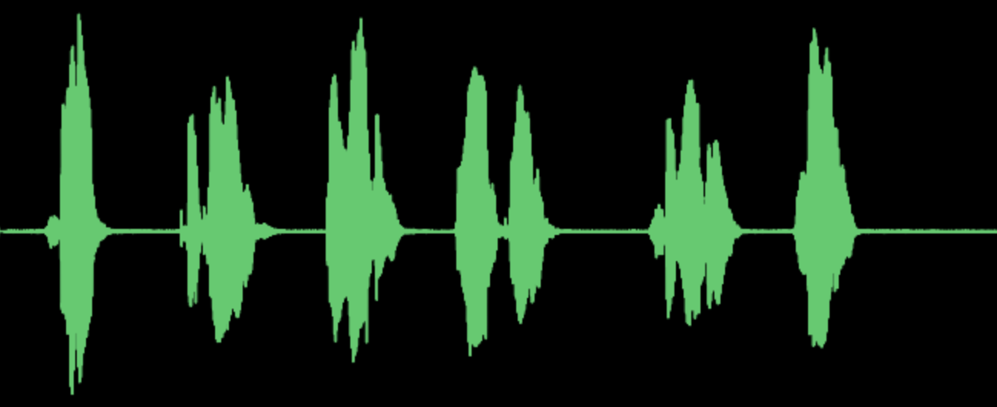
Voice assistant pipeline
Keyword Validation
Intended Query Detection
Speech Recognition
Endpoint Detection
Speech Enhancement
Keyword Detection
Whisper Detection
Emotion Detection
Speaker Identification
Speech Separation
Text Normalization
Punctuation Prediction
Speech Synthesis
Салют, какая погода в Москве?
Сейчас в Москве +15 ⁰С
Assistant platform: Intent recognition, Search, Dialog Management, Skills
Text Normalization
Language Generation

Slide 29
Voice assistant pipeline
Какие основные требования у пользователей? - Простота настройки и интеграции с другими системами - Приватность и безопасность - Качество звука и синтеза речи - Поддержка широкого спектра возможностей - Скорость отклика

Slide 30
User perceived latency
Скорость отклика - Быстрое выполнение команд, без задержек и пауз
User perceived latency – метрика, отражающая воспринимаемое пользователем время задержки между действием и реакцией системы.
В нашем случае можем выделить два примера: - Произношение активационной фразы <-> активация колонки - Произношение голосового запроса <-> получение ответа

Slide 31
Keyword detection
Основная задача в рамках Voice Assistant Pipeline - Детектирование ключевых фраз в аудиопотоке для активации устройства
Салют
Сбер
Афина
Джой

Slide 32
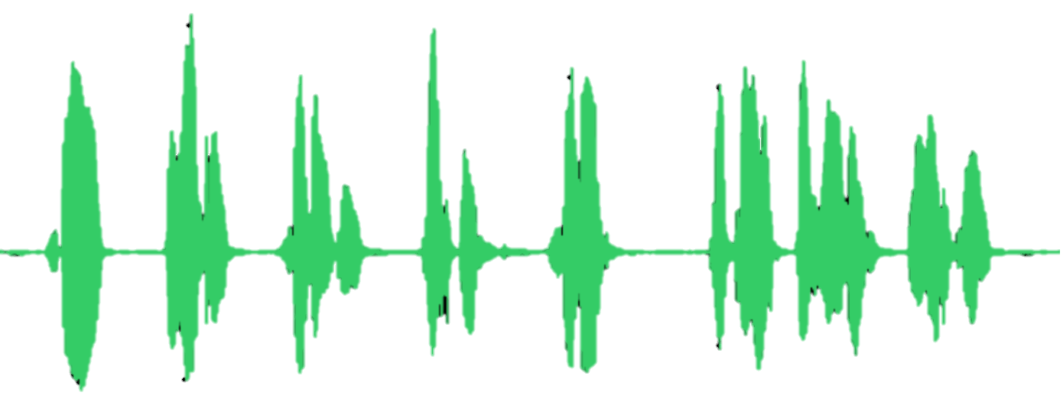
Keyword detection: on-device
100ms / 1500ms
ASR Server

Slide 33
Keyword detection: on-device
Reject
ASR Server

Slide 34
Keyword detection: on-device
Reject
ASR Server

Slide 35
Keyword detection: on-device
Reject
ASR Server

Slide 36
Keyword detection: on-device
Reject
ASR Server

Slide 37
Keyword detection: on-device
Reject
ASR Server

Slide 38
Keyword detection: on-device
Accept
ASR Server

Slide 39
Keyword detection: on-device
Accept
ASR Server

Slide 40
Keyword detection: on-device
Accept
ASR Server

Slide 41
Keyword detection: on-device
Accept
ASR Server

Slide 42
Keyword detection: on-device
Accept
ASR Server

Slide 43
Keyword detection: on-device
Accept
ASR Server
Endpoint detection: True

Slide 44
Keyword detection: on-device
ASR Server
Endpoint detection: True

Slide 45
Keyword detection: on-device
ASR Server
Endpoint detection: True
Assistant platform: Intent recognition, Search, Dialog Management, Skills

Slide 46
Keyword detection: on-device
Преимущества:
- Простота реализации системы - Скорость инференса Недостатки: - Компромисс между точностью, ресурсоемкостью и скоростью

Slide 47
Keyword detection: on-device
Почему on-device?

Slide 48
Keyword detection: on-device
Почему on-device? - Конфиденциальность
ASR Server

Slide 49

Keyword detection: on-device
Почему on-device? - Конфиденциальность
ASR Server

Slide 50

Keyword detection: on-device
Почему on-device? - Конфиденциальность
ASR Server

Slide 51
Keyword detection: on-device
Почему on-device? - Конфиденциальность - Вычислительные мощности
ASR Server

Slide 52
Keyword detection: on-device
Почему on-device? - Конфиденциальность - Вычислительные мощности
ASR Server

Slide 53
Keyword detection: cascade system
ASR Server

Slide 54
Keyword detection: cascade system
Keyword Validation
ASR Server

Slide 55
Keyword detection: cascade system
Reject
Keyword Validation
ASR Server

Slide 56
Keyword detection: cascade system
Reject
Keyword Validation
ASR Server

Slide 57
Keyword detection: cascade system
Reject
Keyword Validation
ASR Server

Slide 58
Keyword detection: cascade system
Reject
Keyword Validation
ASR Server

Slide 59
Keyword detection: cascade system
Reject
Keyword Validation
ASR Server

Slide 60
Keyword detection: cascade system
Accept
Keyword Validation
ASR Server

Slide 61
Keyword detection: cascade system
Accept
Keyword Validation
ASR Server

Slide 62
Keyword detection: cascade system
Accept
Keyword Validation
ASR Server

Slide 63
Keyword detection: cascade system
Accept
Keyword Validation
ASR Server

Slide 64
Keyword detection: cascade system
Accept
Accept
Keyword Validation
ASR Server

Slide 65
Keyword detection: cascade system
Accept
Accept
Keyword Validation
ASR Server

Slide 66
Keyword detection: cascade system
Accept
Accept
Keyword Validation
ASR Server
Endpoint detection: True

Slide 67
Keyword detection: cascade system
Keyword Validation
ASR Server
Endpoint detection: True

Slide 68
Keyword detection: cascade system
Keyword Validation
ASR Server
Endpoint detection: True
Assistant platform: Intent recognition, Search, Dialog Management, Skills

Slide 69
Keyword detection: cascade system
Accept
Keyword Validation
ASR Server

Slide 70
Keyword detection: cascade system
Accept
Reject
Keyword Validation
ASR Server

Slide 71
Keyword detection: cascade system
Accept
Reject
Keyword Validation
ASR Server
Endpoint detection: True

Slide 72
Keyword detection: cascade system
Keyword Validation
ASR Server
Endpoint detection: True

Slide 73
Keyword detection: cascade system
Преимущества: - Высокая точность - Гибкость системы Недостатки: - Дополнительные вычислительные расходы

Slide 74
Keyword detection: complex cascade system
Что может быть еще? - Валидация рекламы

Slide 75
Keyword detection: complex cascade system
Accept
Accept
Keyword Validation
ASR Server
Advertising Validation

Slide 76
Keyword detection: complex cascade system
Accept
Accept
Keyword Validation
ASR Server
Advertising Validation
Reject

Slide 77
Keyword detection: complex cascade system
Keyword Validation
ASR Server
Advertising Validation
Reject

Slide 78
Keyword detection: complex cascade system
Что может быть еще? - Быстрые команды, habr
Keyword Detection
Keyword Validation
ASR
ASR Server
Advertising Validation

Slide 79
Keyword detection: complex cascade system
Что может быть еще? - Быстрые команды, habr
Keyword Detection
Keyword Validation
ASR
ASR Server
Advertising Validation

Slide 80
Keyword detection: complex cascade system
Что может быть еще? - Быстрые команды, habr
Keyword Detection
Keyword Validation
ASR
ASR Server
Advertising Validation

Slide 81
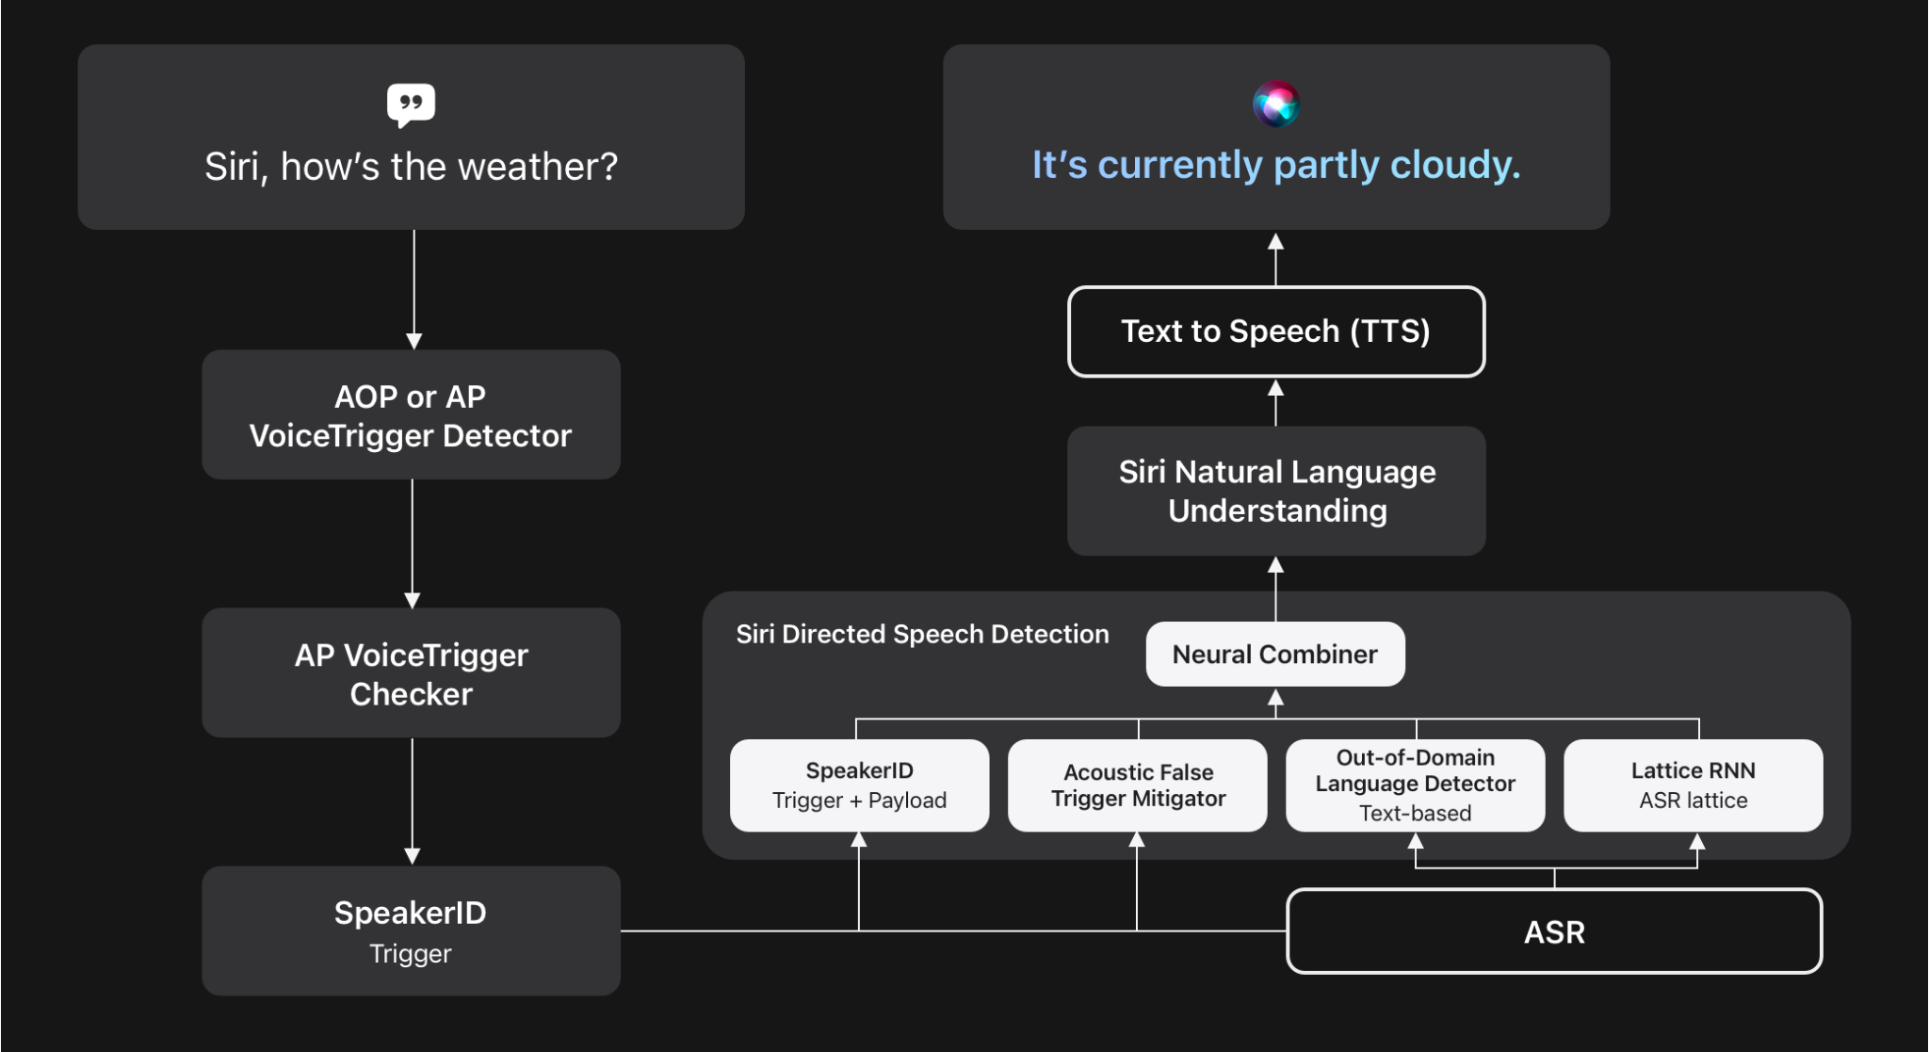
Keyword detection: complex cascade system
Voice Trigger System for Siri: Apple, 2023

Slide 82
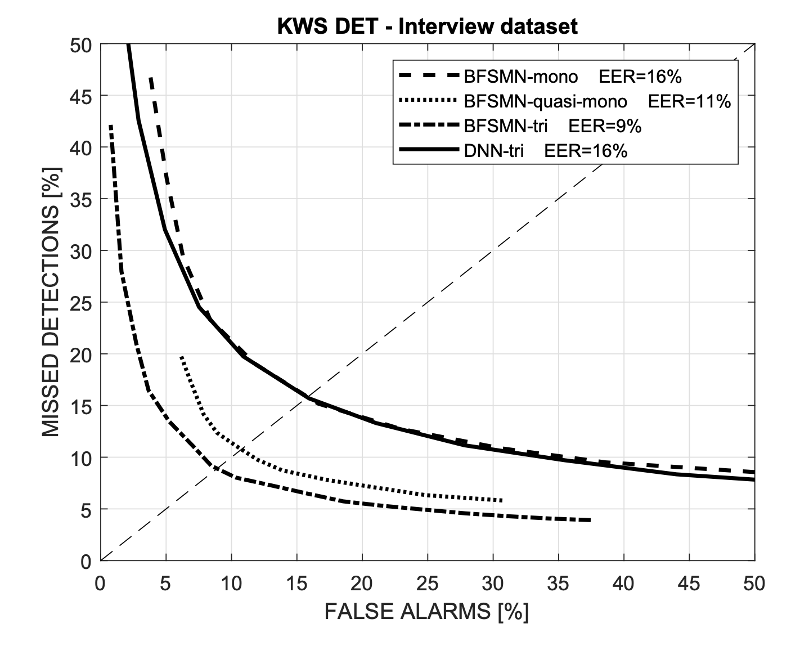
Keyword detection: метрики
FAR: False (Activation / Accepts / Alarm) Rate - FAR = FP / (FP + TN)
FRR: False Rejects Rate - FRR = FN / (FN + TP) FAh: False Accepts per hour - Количество ложных срабатываний в час
Detection Error Tradeoff

Slide 83
User perceived latency
Скорость отклика - Быстрое выполнение команд, без задержек и пауз
User perceived latency – метрика, отражающая воспринимаемое пользователем время задержки между действием и реакцией системы.
В нашем случае можем выделить два примера: - Произношение активационной фразы <-> активация колонки - Произношение голосового запроса <-> получение ответа

Slide 84
Endpoint detection
Основная задача в рамках Voice Assistant Pipeline - Определение конца голосового запроса пользователя для завершения приема аудиосигнала и начала подготовки ответа

Slide 85
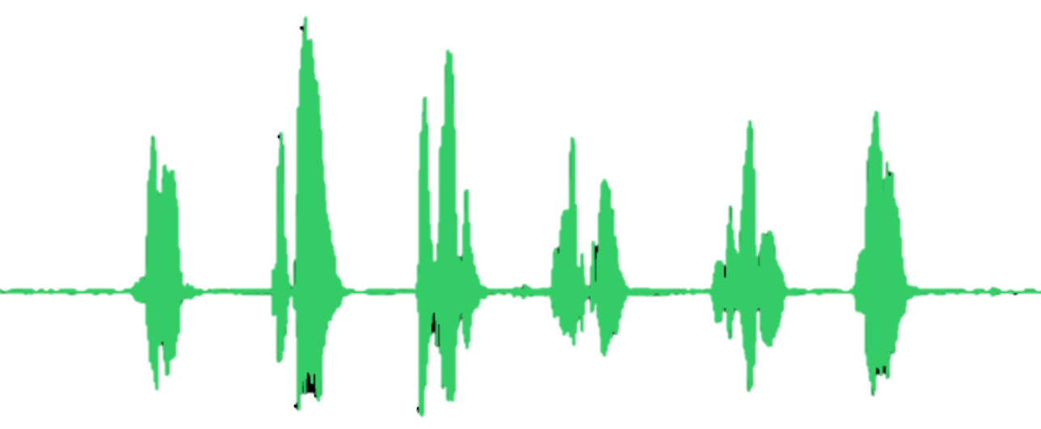
Endpoint detection
threshold
1 – endpoint: true 0 – endpoint: false
0 < x < 1
100ms

Slide 86
Endpoint detection
0.10
threshold = 0.5

Slide 87
Endpoint detection
0.15
0.10
threshold = 0.5

Slide 88
Endpoint detection
0.28
0.15
0.10
threshold = 0.5

Slide 89
Endpoint detection
0.43
0.28
0.15
0.10
threshold = 0.5

Slide 90
Endpoint detection
0.55
0.43
0.28
0.15
0.10
threshold = 0.5

Slide 91
Endpoint detection
0.55
0.43
0.28
0.15
0.10
threshold = 0.5
0
0
0
0
0
References

Slide 92
Endpoint detection
0.55
0.43
0.28
0.15
0.10
threshold = 0.5
0
0
0
0
0
References
Early activation

Slide 93
Endpoint detection
0.55
0.43
0.28
0.15
0.10
threshold = 0.8
0
0
0
0
0
References

Slide 94
Endpoint detection
0.05
0.55
0.43
0.28
0.15
0.10
threshold = 0.8
0
0
0
0
0
References

Slide 95
Endpoint detection
0.21
0.05
0.55
0.43
0.28
0.15
0.10
threshold = 0.8
0
0
0
0
0
References

Slide 96
Endpoint detection
0.48
0.21
0.05
0.55
0.43
0.28
0.15
0.10
threshold = 0.8
0
0
0
0
0
References

Slide 97
Endpoint detection
0.83
0.48
0.21
0.05
0.55
0.43
0.28
0.15
0.10
threshold = 0.8
0
0
0
0
0
References

Slide 98
Endpoint detection
0.83
0.48
0.21
0.05
0.55
0.43
0.28
0.15
0.10
threshold = 0.8
1
0
0
0
0
0
References

Slide 99
Endpoint detection
0.83
0.48
0.21
0.05
0.55
0.43
0.28
0.15
0.10
threshold = 0.8
1
0
0
0
0
0
References
Late activation == latency 300ms

Slide 100

Endpoint detection: метрики

Slide 101
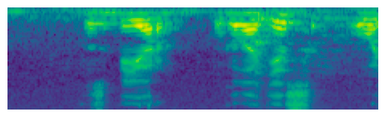
Endpoint detection: audio features
ASR Server
Feature extractor
Endpoint detection

Slide 102
Endpoint detection: audio features
ASR Server
Endpoint detection
False
Assistant platform: Intent recognition, Search, Dialog Management, Skills

Slide 103
Endpoint detection: audio features
ASR Server
Endpoint detection
False
Assistant platform: Intent recognition, Search, Dialog Management, Skills

Slide 104
Endpoint detection: audio features
ASR Server
Endpoint detection
False
Assistant platform: Intent recognition, Search, Dialog Management, Skills

Slide 105
Endpoint detection: audio features
ASR Server
Endpoint detection
False
Assistant platform: Intent recognition, Search, Dialog Management, Skills

Slide 106
Endpoint detection: audio features
ASR Server
Endpoint detection
False
Assistant platform: Intent recognition, Search, Dialog Management, Skills

Slide 107
Endpoint detection: audio features
ASR Server
Endpoint detection
False
Assistant platform: Intent recognition, Search, Dialog Management, Skills

Slide 108
Endpoint detection: audio features
ASR Server
Endpoint detection
True
Assistant platform: Intent recognition, Search, Dialog Management, Skills

Slide 109
Endpoint detection: audio features
ASR Server
Endpoint detection
True
Assistant platform: Intent recognition, Search, Dialog Management, Skills

Slide 110
Endpoint detection: audio features
Преимущества: - Скорость инференса - Простота системы Недостатки: - Точность - Не учитываем текстовые признаки
ASR Server
Endpoint detection
True
Assistant platform: Intent recognition, Search, Dialog Management, Skills

Slide 111
Endpoint detection: audio features
Что еще?

Slide 112
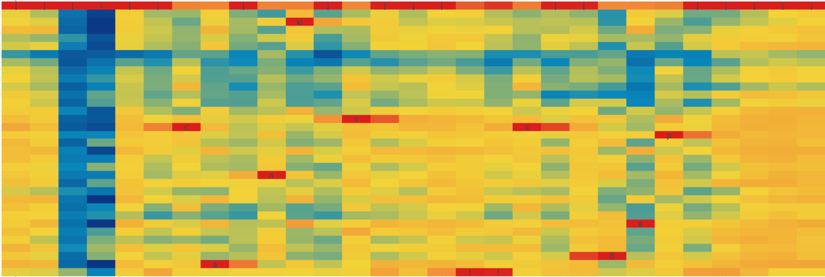
Endpoint detection: audio features
Feature Extractor
Предсказание конца запроса по логитам CTC
Char-CTC Acoustic Model

Slide 113
Endpoint detection: text features
Предсказание конца запроса на основе text features - Оценка завершенности запроса по гипотезам ASR

Slide 114
Endpoint detection: text features
ASR Server
Acoustic Model
Endpoint detection
Text embedding
Top-1 hypotheses
Decoding [LM]

Slide 115
Endpoint detection: text features
ASR Server
Endpoint detection
False
Assistant platform: Intent recognition, Search, Dialog Management, Skills

Slide 116
Endpoint detection: text features
ASR Server
салют
Endpoint detection
False
Assistant platform: Intent recognition, Search, Dialog Management, Skills

Slide 117
Endpoint detection: text features
ASR Server
салют какая
Endpoint detection
False
Assistant platform: Intent recognition, Search, Dialog Management, Skills

Slide 118
Endpoint detection: text features
ASR Server
салют какая погода
Endpoint detection
False
Assistant platform: Intent recognition, Search, Dialog Management, Skills

Slide 119
Endpoint detection: text features
ASR Server
салют какая погода в
Endpoint detection
False
Assistant platform: Intent recognition, Search, Dialog Management, Skills

Slide 120
Endpoint detection: text features
ASR Server
салют какая погода в москве
Endpoint detection
False
Assistant platform: Intent recognition, Search, Dialog Management, Skills

Slide 121
Endpoint detection: text features
ASR Server
салют какая погода в москве
Endpoint detection
True
Assistant platform: Intent recognition, Search, Dialog Management, Skills

Slide 122
Endpoint detection: text features
ASR Server
салют какая погода в москве
Endpoint detection
True
Assistant platform: Intent recognition, Search, Dialog Management, Skills

Slide 123
Endpoint detection: text features
Преимущества: - Скорость инференса - Простота системы Недостатки: - Точность - Не учитываем аудио признаки - Ошибки ASR модели
ASR Server
салют какая погода в москве
Endpoint detection
True
Assistant platform: Intent recognition, Search, Dialog Management, Skills

Slide 124
Endpoint detection: multimodal system
Предсказание конца запроса на основе audio & text features

Slide 125
Endpoint detection: multimodal system
Предсказание конца запроса на основе audio & text features Как можно объединить audio & text features?

Slide 126
Endpoint detection: multimodal system
Audio embedding
Text embedding

Slide 127
Endpoint detection: multimodal system
Audio embedding
Text embedding
Endpoint Detection
Endpoint Detection
Audio prediction
Text prediction
Audio threshold
Prediction
Text threshold

Slide 128
Endpoint detection: multimodal system
Audio embedding
Text embedding
Audio encoder
Text encoder
Concat
Endpoint Detection
Prediction

Slide 129
Endpoint detection: multimodal system
Преимущества: - Точность - Учет audio & text признаков Недостатки: - Сложность системы
ASR Server
салют какая погода в москве
Endpoint detection
True
Assistant platform: Intent recognition, Search, Dialog Management, Skills

Slide 130
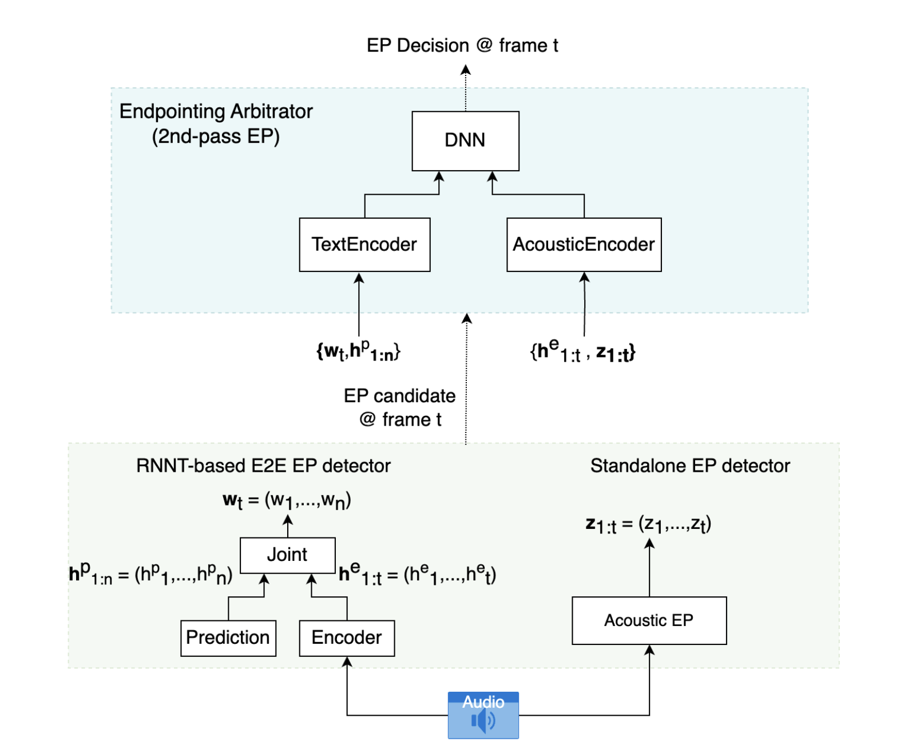
Endpoint detection: multimodal system
Two-pass endpoint detection for speech recognition: Amazon Alexa AI, 2024

Slide 131
User perceived latency
Скорость отклика - Быстрое выполнение команд, без задержек и пауз
User perceived latency – метрика, отражающая воспринимаемое пользователем время задержки между действием и реакцией системы.
В нашем случае можем выделить два примера: - Произношение активационной фразы <-> активация колонки - Произношение голосового запроса <-> получение ответа

Slide 132
User perceived latency: prefetch recognition
Основная задача в рамках Voice Assistant Pipeline - Оценка завершенности частично распознанного запроса

Slide 133
User perceived latency: prefetch recognition
ASR Server
Endpoint detection
False
Prefetch
False
Assistant platform: Intent recognition, Search, Dialog Management, Skills

Slide 134
User perceived latency: prefetch recognition
ASR Server
салют
Endpoint detection
False
Prefetch
False
Assistant platform: Intent recognition, Search, Dialog Management, Skills

Slide 135
User perceived latency: prefetch recognition
ASR Server
салют какая
Endpoint detection
False
Prefetch
False
Assistant platform: Intent recognition, Search, Dialog Management, Skills

Slide 136
User perceived latency: prefetch recognition
ASR Server
салют какая погода
Endpoint detection
False
Prefetch
False
Assistant platform: Intent recognition, Search, Dialog Management, Skills

Slide 137
User perceived latency: prefetch recognition
ASR Server
салют какая погода
Endpoint detection
False
Prefetch
True
Assistant platform: Intent recognition, Search, Dialog Management, Skills

Slide 138
User perceived latency: prefetch recognition
ASR Server
салют какая погода
Endpoint detection
False
Prefetch
True
Assistant platform: Intent recognition, Search, Dialog Management, Skills

Slide 139
User perceived latency: prefetch recognition
ASR Server
салют какая погода
Endpoint detection
False
Prefetch
True
Assistant platform: Intent recognition, Search, Dialog Management, Skills

Slide 140
User perceived latency: prefetch recognition
ASR Server
салют какая погода
Endpoint detection
False
Prefetch
True
Assistant platform: Intent recognition, Search, Dialog Management, Skills

Slide 141
User perceived latency: prefetch recognition
ASR Server
салют какая погода
Endpoint detection
True
Prefetch
True
Assistant platform: Intent recognition, Search, Dialog Management, Skills

Slide 142
User perceived latency: prefetch recognition
ASR Server
салют какая погода
Endpoint detection
True
Prefetch
True
Assistant platform: Intent recognition, Search, Dialog Management, Skills

Slide 143
User perceived latency: prefetch recognition
Основная задача в рамках Voice Assistant Pipeline - Оценка завершенности частично распознанного запроса
Преимущества: - Снижаем user perceived latency за счет уменьшения latency на уровне Assistant Platform
Недостатки: - Дополнительная нагрузка на Assistant Platform

Slide 144
User perceived latency: prefetch recognition
ASR Server
салют какая погода
Endpoint detection
False
Prefetch
True
Assistant platform: Intent recognition, Search, Dialog Management, Skills

Slide 145
User perceived latency: prefetch recognition
ASR Server
салют какая погода в
Endpoint detection
False
Prefetch
False
Assistant platform: Intent recognition, Search, Dialog Management, Skills

Slide 146
User perceived latency: prefetch recognition
ASR Server
салют какая погода в москве
Endpoint detection
False
Prefetch
False
Assistant platform: Intent recognition, Search, Dialog Management, Skills

Slide 147
User perceived latency: prefetch recognition
ASR Server
салют какая погода в москве
Endpoint detection
False
Prefetch
True
Assistant platform: Intent recognition, Search, Dialog Management, Skills

Slide 148
User perceived latency: prefetch recognition
ASR Server
салют какая погода в москве сейчас
Endpoint detection
False
Prefetch
False
Assistant platform: Intent recognition, Search, Dialog Management, Skills

Slide 149
User perceived latency: prefetch recognition
ASR Server
салют какая погода в москве сейчас
Endpoint detection
True
Prefetch
False
Assistant platform: Intent recognition, Search, Dialog Management, Skills

Slide 150
User perceived latency: prefetch recognition
ASR Server
салют какая погода в москве сейчас
Endpoint detection
True
Prefetch
False
Assistant platform: Intent recognition, Search, Dialog Management, Skills

Slide 151
Итоги:
Voice assistant pipeline
User perceived latency - Keyword detection - Подходы: on-device, cascade system, complex cascade system - Метрики: FAR, FRR, FAh - Endpoint detection - Подходы: audio / text only, audio & text - Метрики: WERR, EEPR, latency - Prefetch recognition

